Slide 1
Dataplex Data Quality Task on GBQ

Slide 2
About Dataplex.?
Dataplex is an intelligent data fabric that helps unify distributed data and automate data management and governance across that data to power analytics at scale.
For data stored in Cloud Storage and BigQuery, Dataplex enables you to,
Build a domain-specific data mesh across data stored in multiple Google Cloud projects, without any data movement.
1
Automate metadata discovery and make the data securely accessible and available for querying via BigQuery as external tables, and open-source applications such as SparkSQL, Presto, and HiveQL.
2
Run data quality and data lifecycle management tasks, including serverless Spark tasks.
3
Explore data using fully-managed, serverless Spark environments with simple access to notebooks and SparkSQL queries.
4

Slide 3
- Wants to validate data as part of the data production pipeline
- Wants to Monitor quality of datasets
- Wants to Build data quality reports for regulatory requirements.
When to create Dataplex data quality tasks

Slide 4
- Highly flexible specification
Provides a highly flexible YAML syntax for declaring your data quality rules.
- Entirely serverless execution
Dataplex handles execution. Users don't need to do any infrastructure setup.
- Zero-copy and native push-down
YAML checks are converted to SQL and pushed down to BigQuery, resulting in no data copy.
- Schedule data quality checks
You can schedule data quality checks through Dataplex's serverless scheduler or use the Dataplex API through external schedulers like Cloud Composer for pipeline integration.
- Managed experience
Dataplex uses an open-source data quality engine, CloudDQ, to run data quality checks. However, Dataplex provides a one-click, managed experience for operationalizing your data quality checks
Benefits of Dataplex data quality tasks

Slide 5
- When executing Dataplex data quality tasks, you are charged for BigQuery and Dataproc Serverless (Batches) usage
- Dataplex data quality task converts the specification file to BigQuery queries and executes them in the user project.
- Dataplex uses Spark to run the prebuilt, Google-maintained open source CloudDQ driver program, to convert user specification to BigQuery queries
- There is no charge for using Dataplex to organize data and using Dataplex's serverless scheduler to schedule data quality checks.
Cost

Slide 6
All the tables specified for a given data quality task must belong to the same Google Cloud region
The tables to be checked for quality, and the table where the output metrics are stored, should also be in the same Google Cloud region.
Limitations of Dataplex data quality tasks

Slide 7
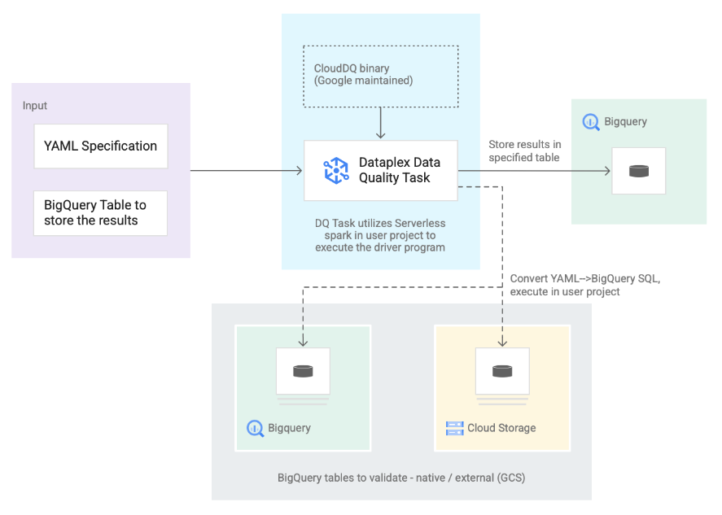
How Dataplex Data Quality Tasks works

Slide 8
1. Input from users
YAML Specification: A set of one or more YAML files, stored in a Cloud Storage bucket in your project, that define data quality rules per the specification syntax. Users can run multiple rules at a time and those rules can be applied to different BigQuery tables, including tables across different datasets or Google Cloud projects. Syntax supports incremental executions for validating newer data only.
BigQuery result table: A user-specified table where the data quality validation results are to be stored. The Google Cloud project in which this table resides can be a different project than the one in which the Dataplex data quality task is used.
2. Tables to validate
Within the YAML specification you need to specify which table(s) you want to validate for which rules (also known as a "rule binding"). The tables can be BigQuery native tables or BigQuery external tables in Cloud Storage. YAML specification is flexible enough to allow for specifying tables in a Dataplex zone or outside of a zone.
BigQuery and Cloud Storage tables validated in a single execution can belong to different projects.
3. Dataplex data quality task
A Dataplex data quality task is configured with a prebuilt, maintained CloudDQ Pyspark binary and takes the YAML specification and BigQuery result table as the input. Just as any other Dataplex task, the Dataplex data quality task executes on a serverless Spark environment

